Slide 1
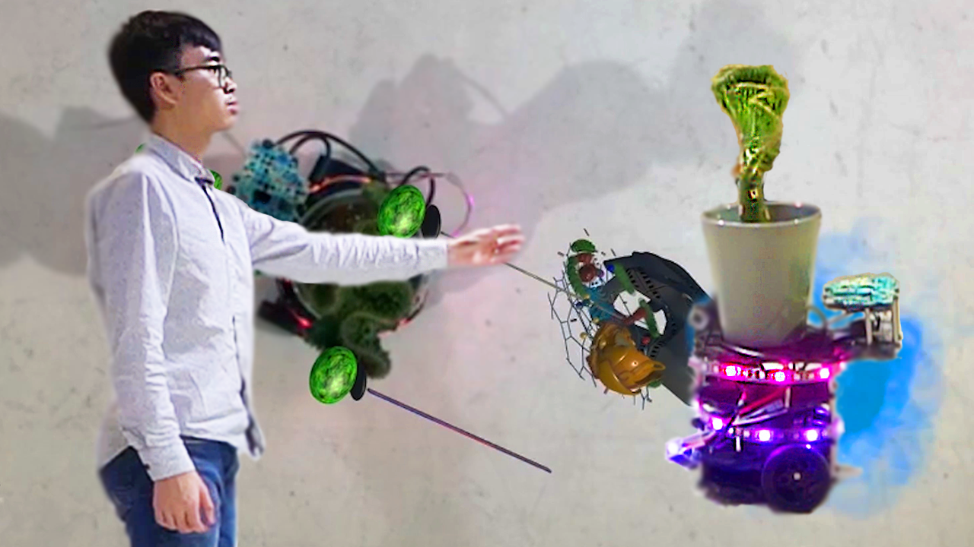
The Last Cyborgian Plant
Progress Report 1
Jie Guan

Slide 2
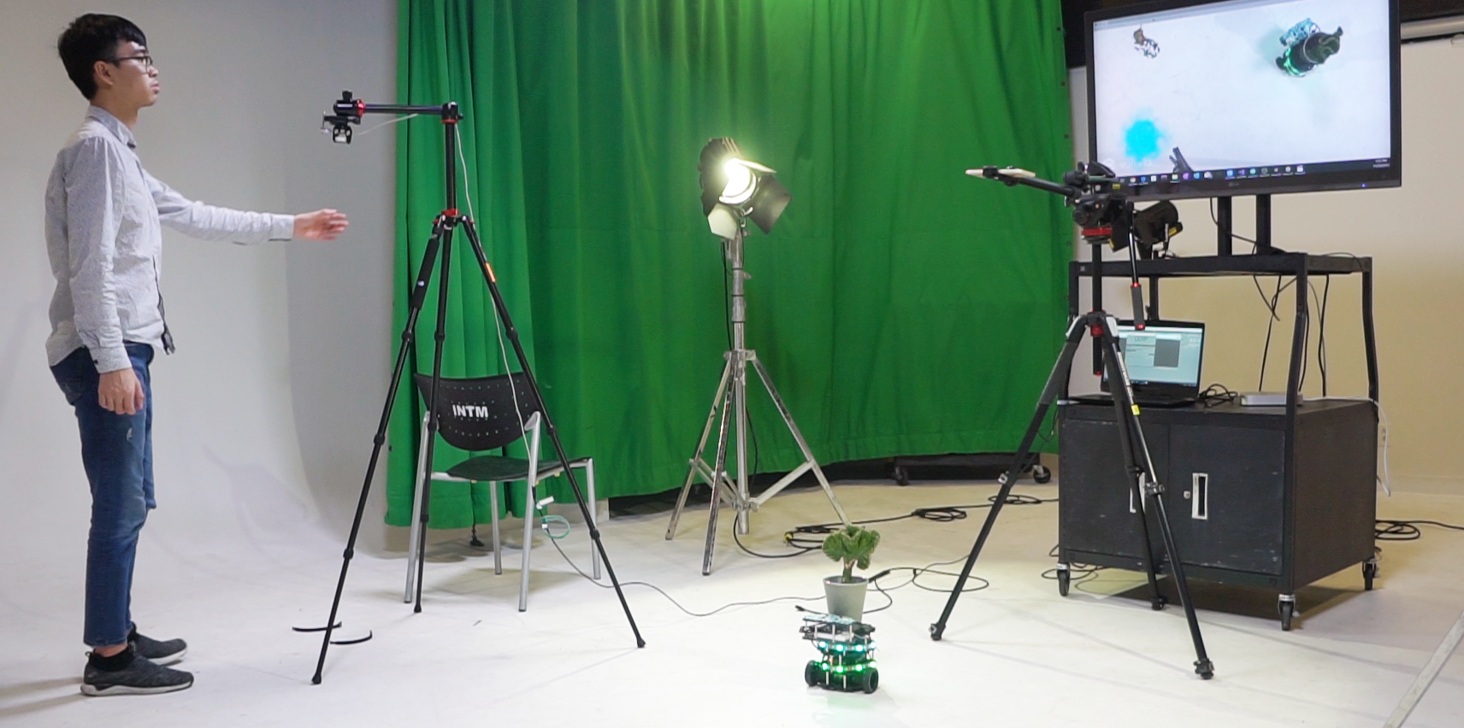
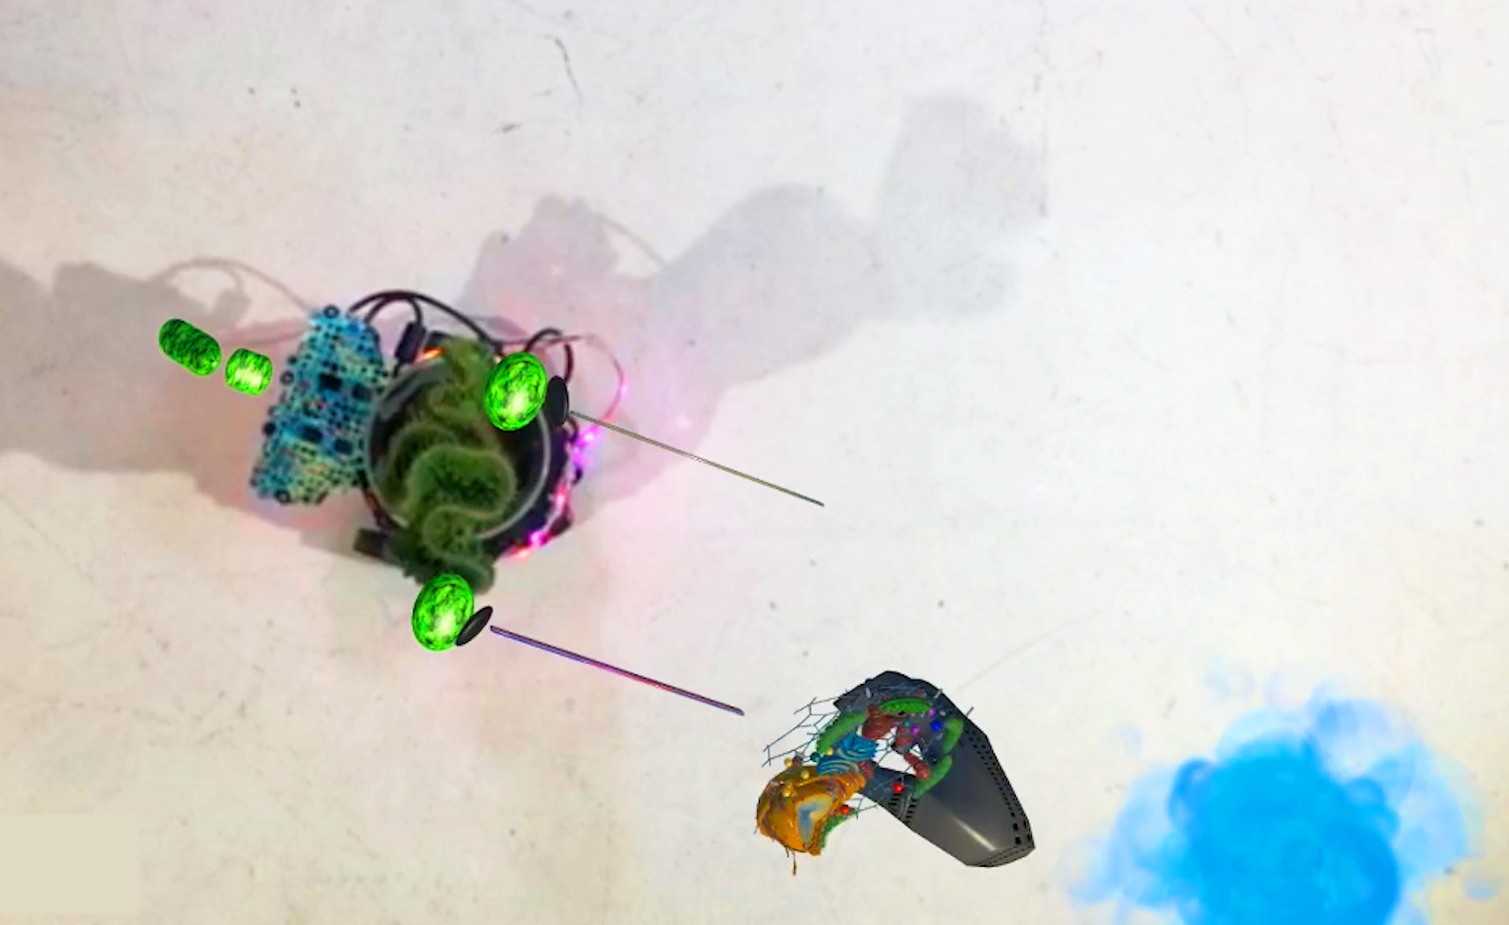
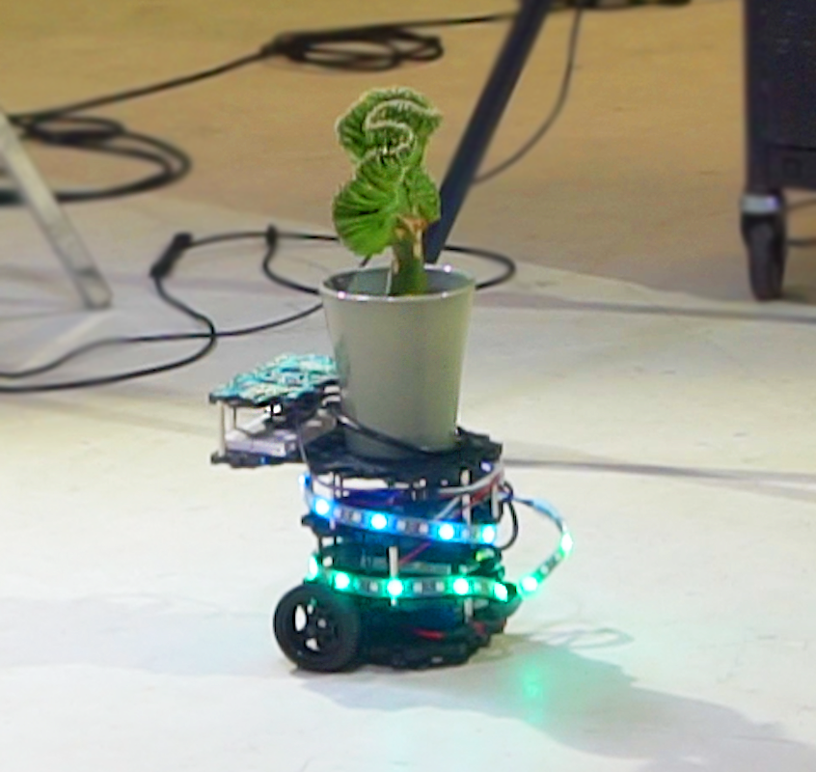
What I Did on Last Semester

Slide 3
Next Step
Improve the Visual Element:
The cell elements will be presented as chloroplast, which operates photosynthesis to convert the energy from sunlight into energy for plant.(Done)
The box, a stage for presenting and containing the cyborg plant, need to be futurist texture.(In Process)
Context Research(In Process)
The virtual elements on the plant to enhance the feeling of cyborg, as well as hybrid virtual and physical object.(No Idea)

Slide 4
Plant Cell Exploration

Slide 5
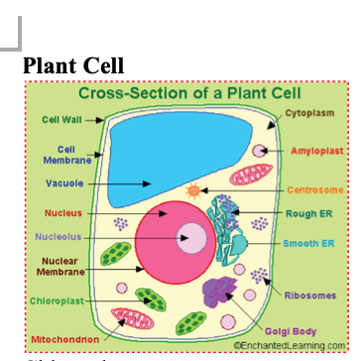
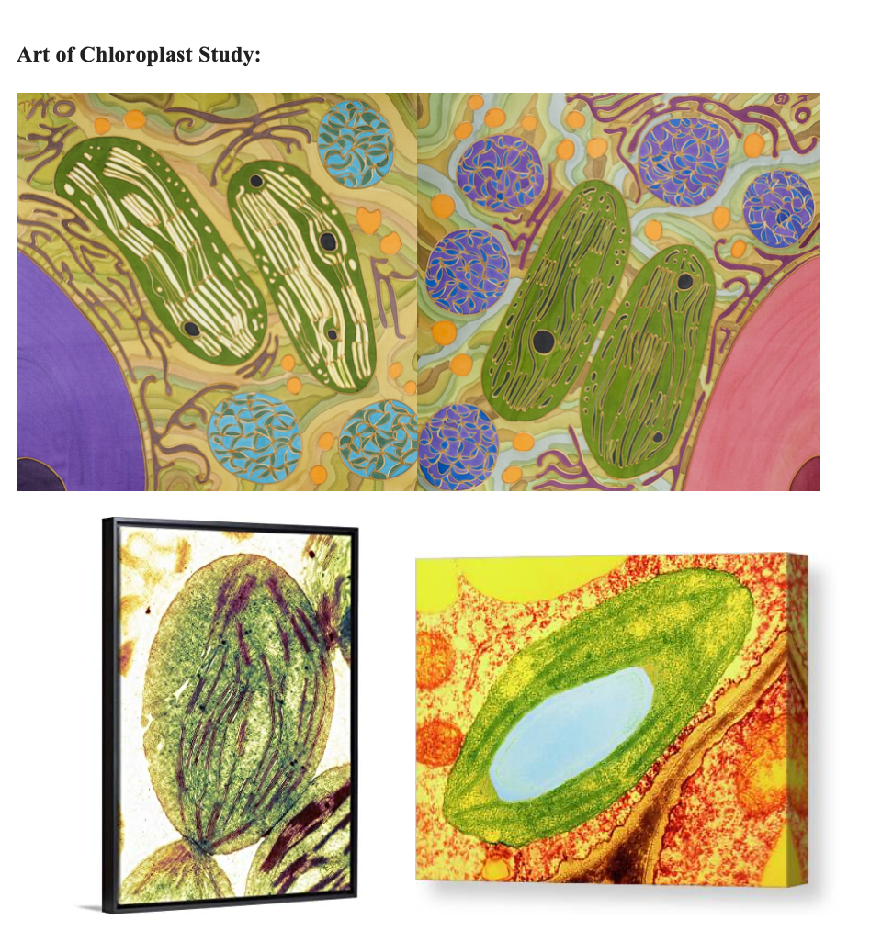
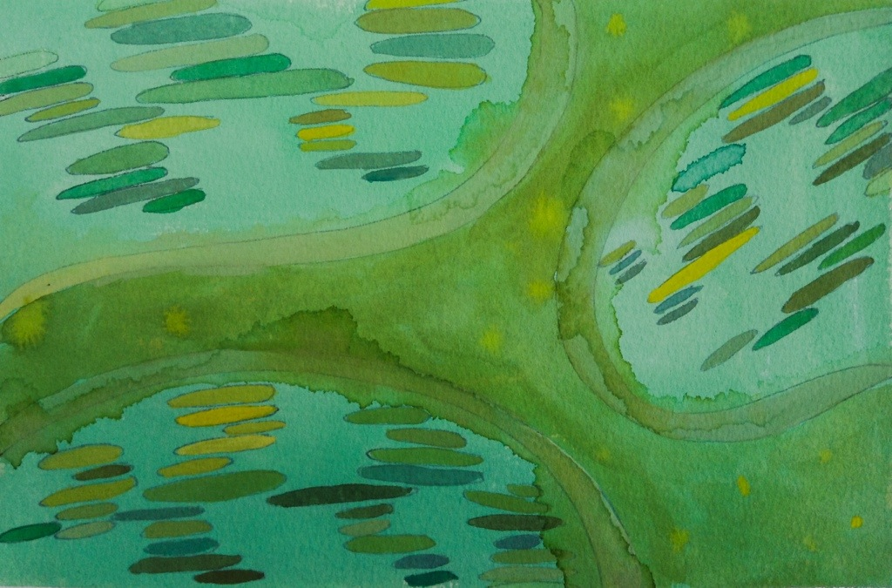
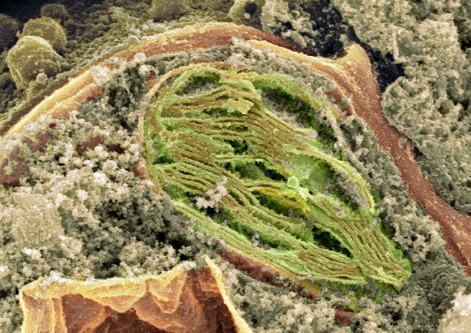
Plant Cell Study
Chloroplast:
An elongated or disc-shaped organelle containing chlorophyll. Photosynthesis (in which energy from sunlight is converted into chemical energy – food) takes place in the chloroplasts.
Chlorophyll:
Chlorophyll is a molecule that can use light energy from sunlight to turn water and carbon dioxide gas into sugar and
oxygen (this process is called photosynthesis). Chlorophyll is magnesium based and is usually green.

Slide 6
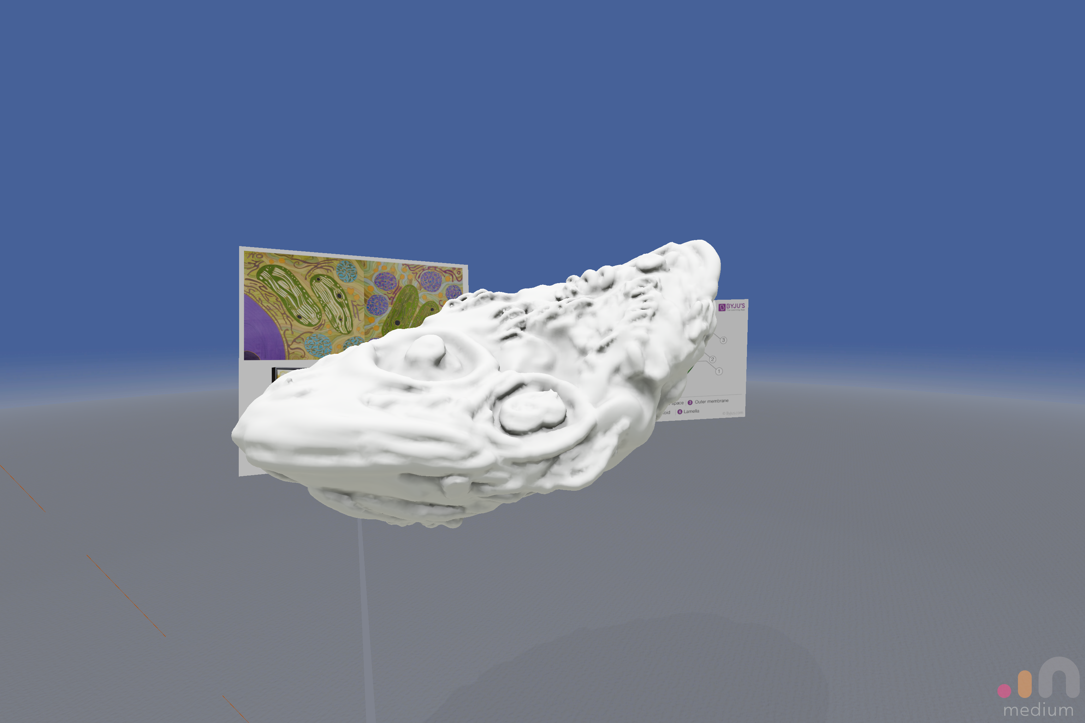
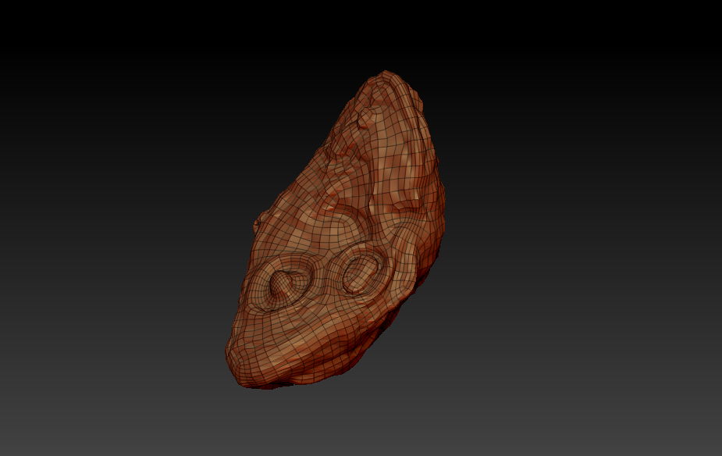
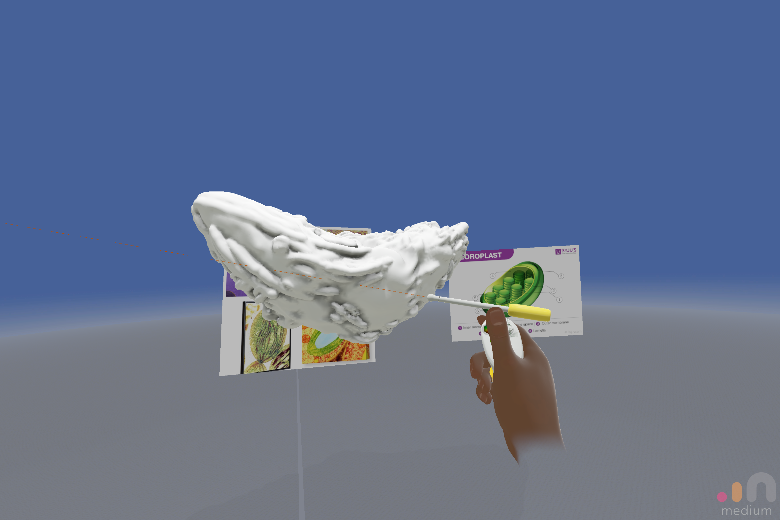
3D Modeling

Slide 7
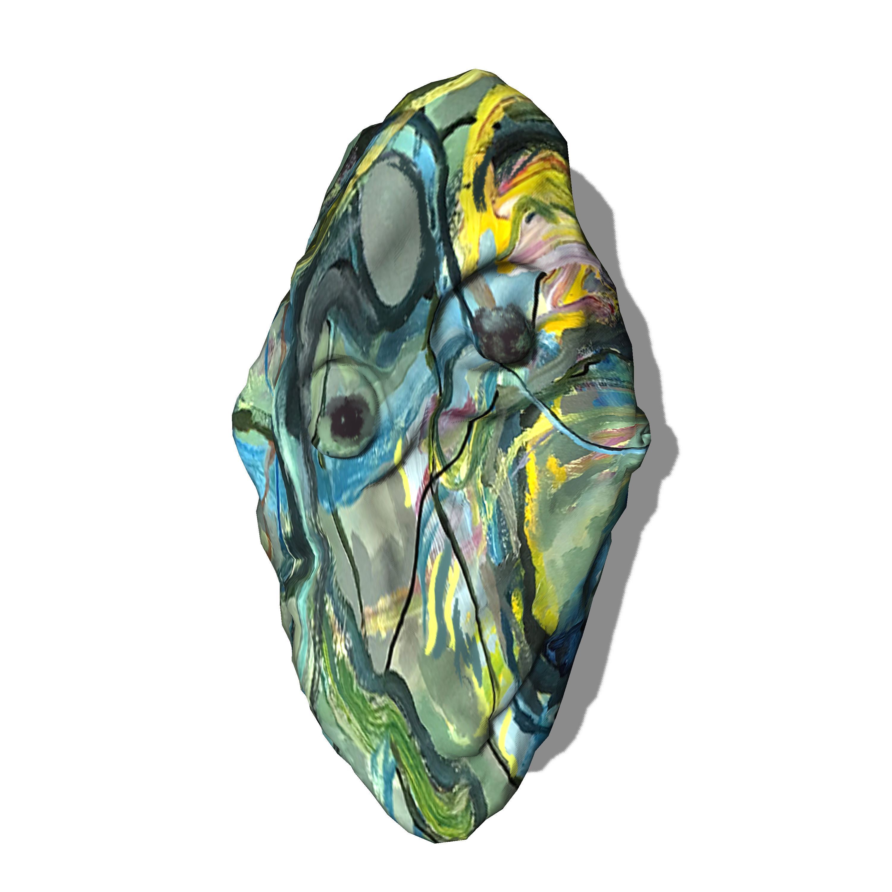
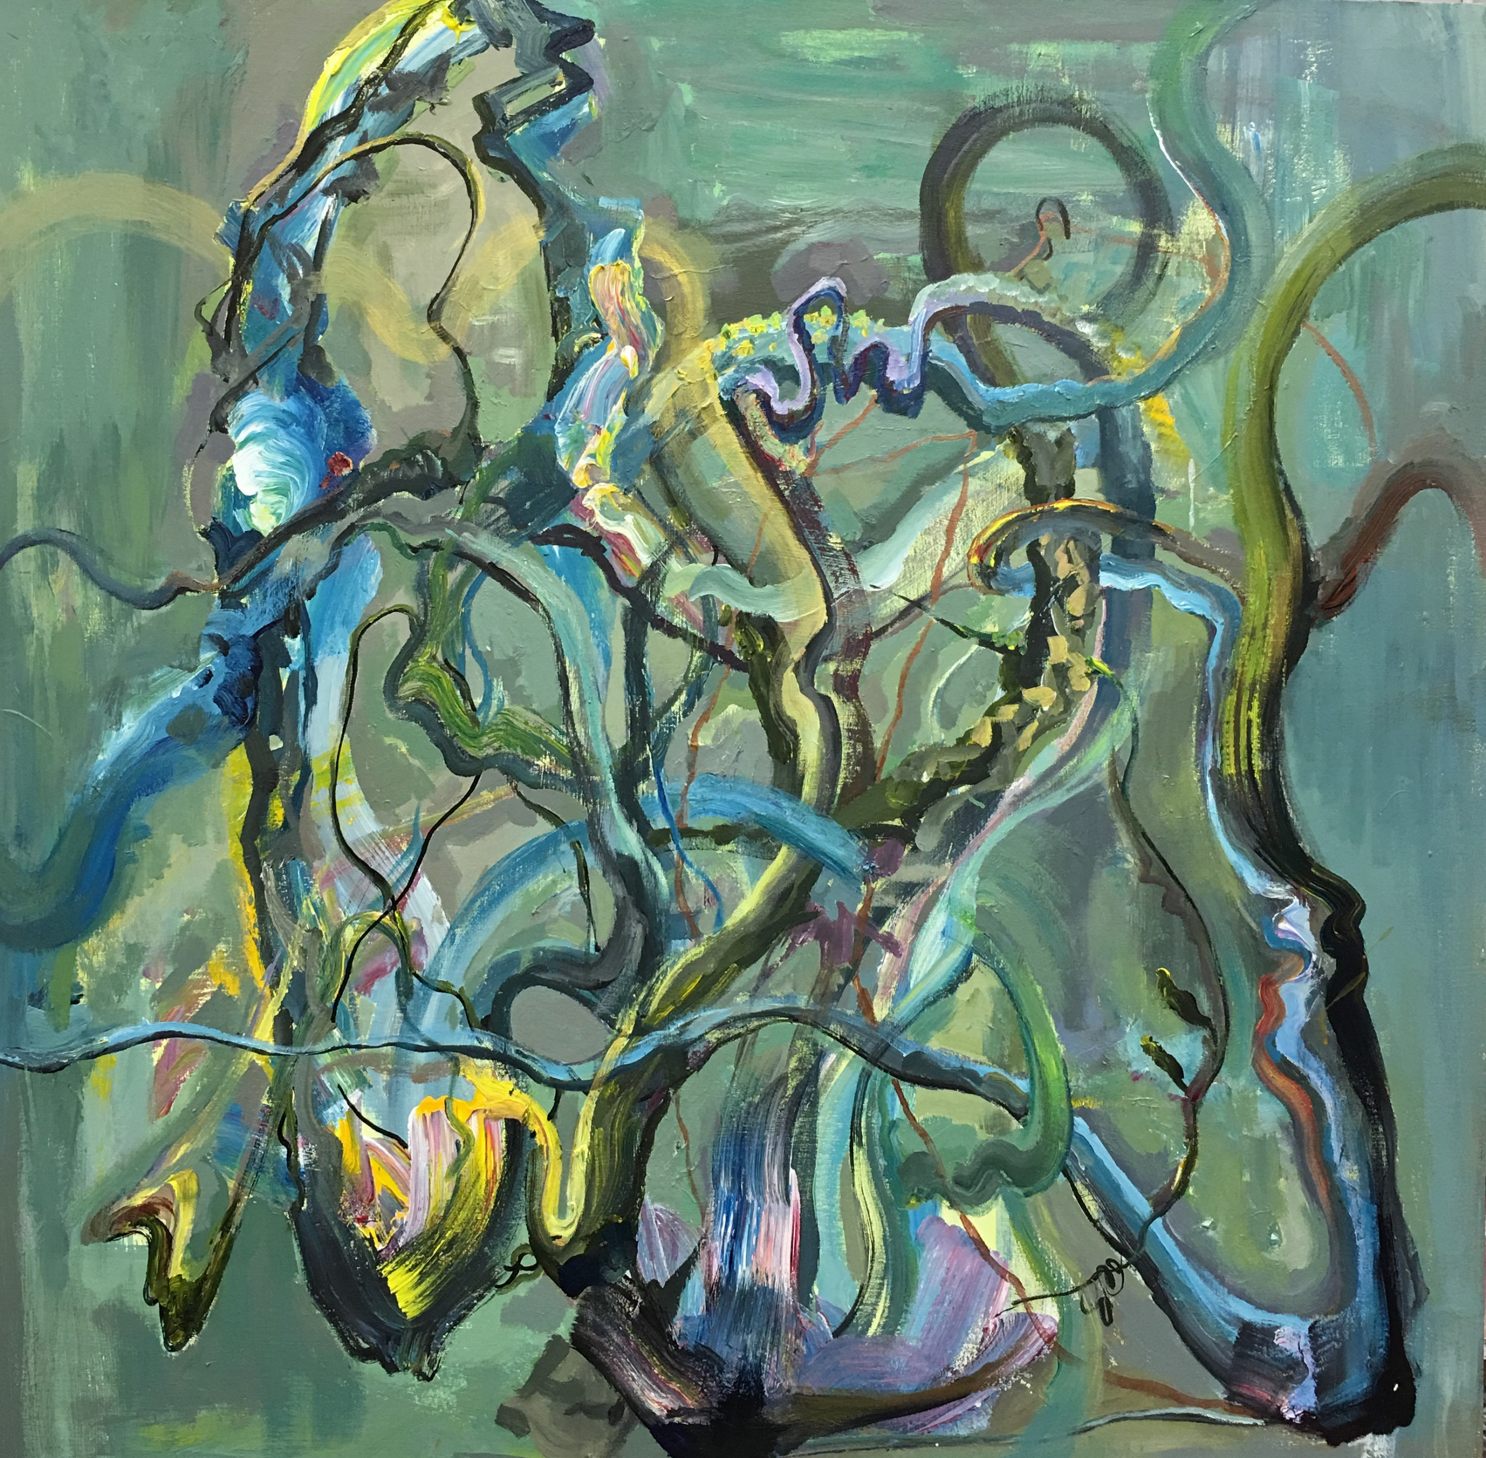
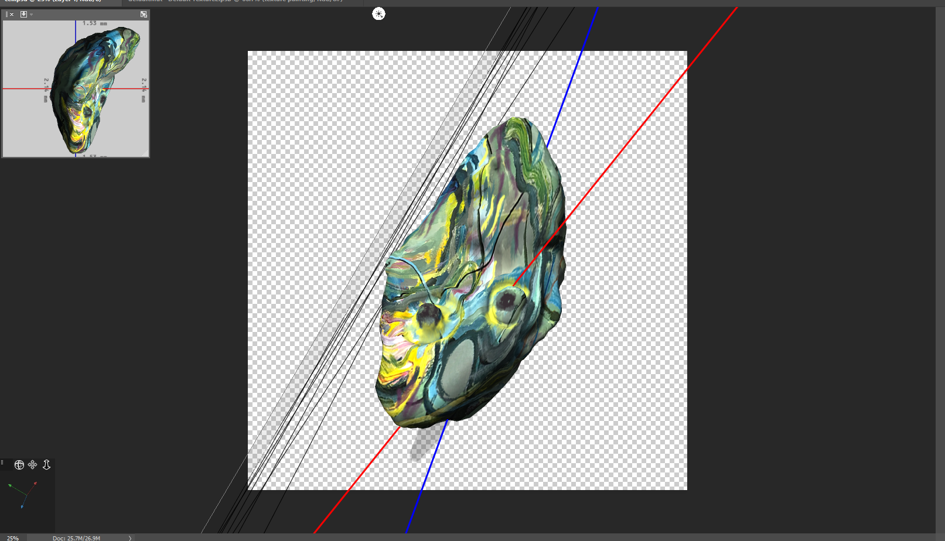
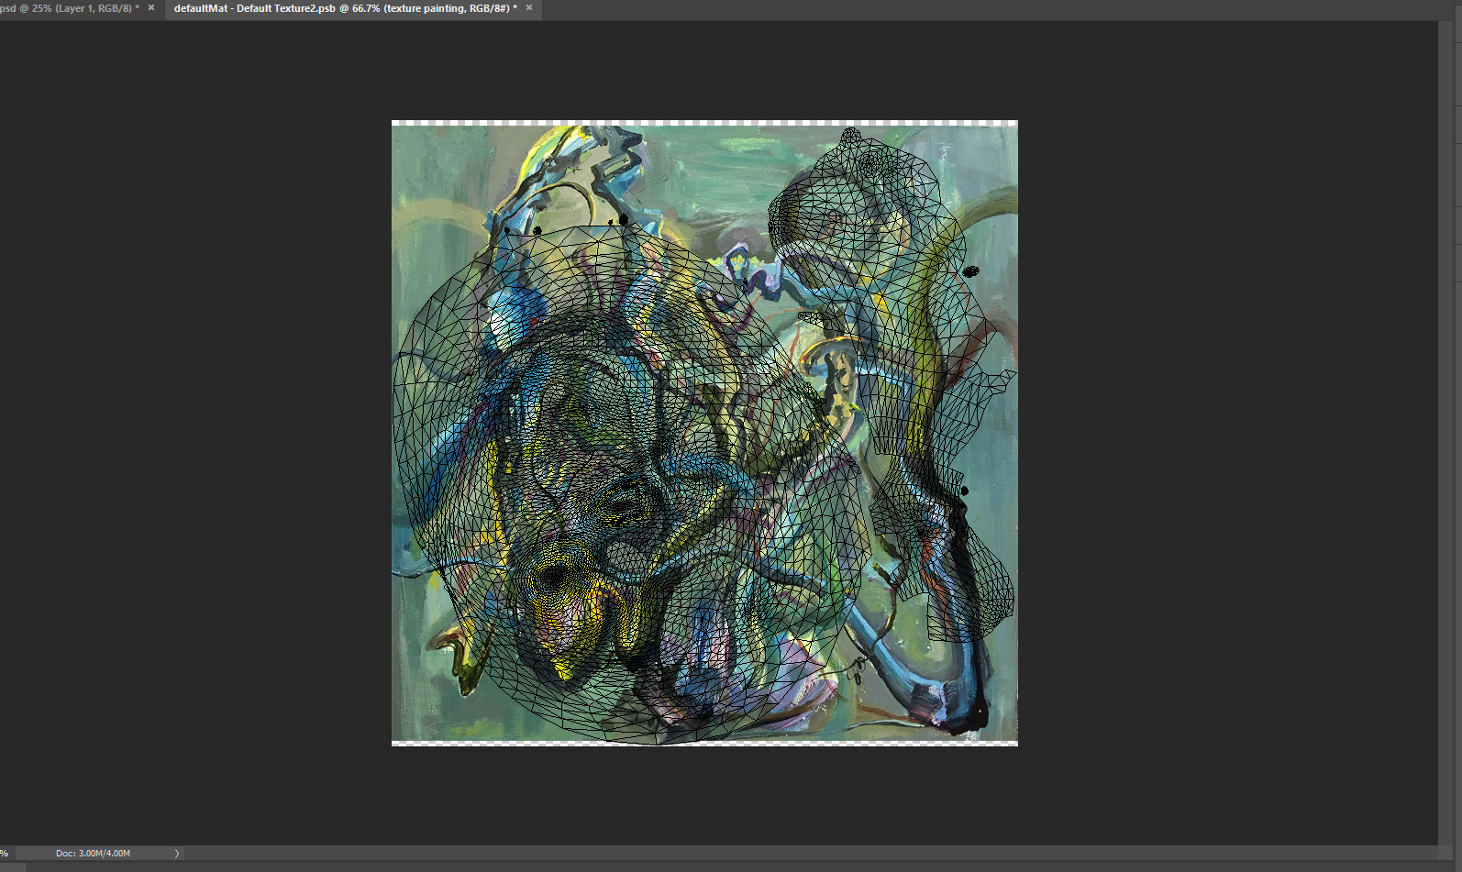
Texturing

Slide 8
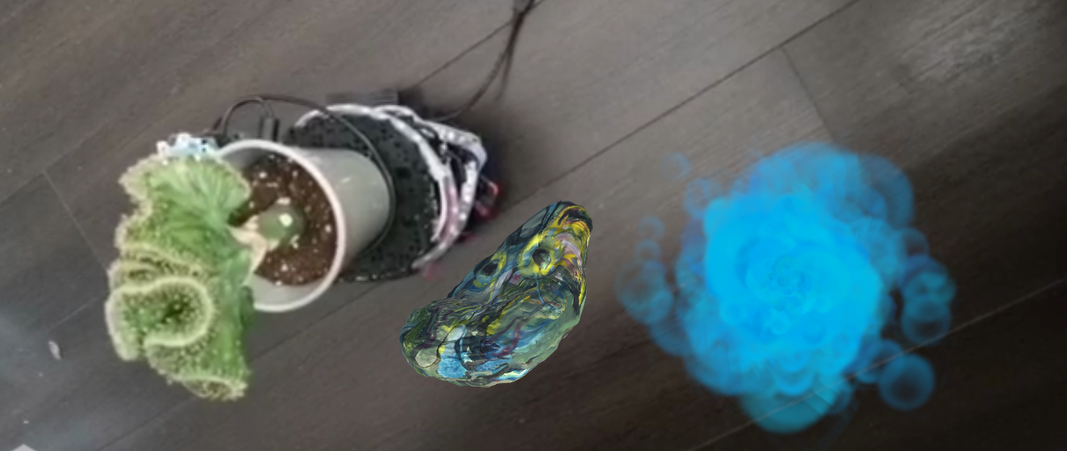
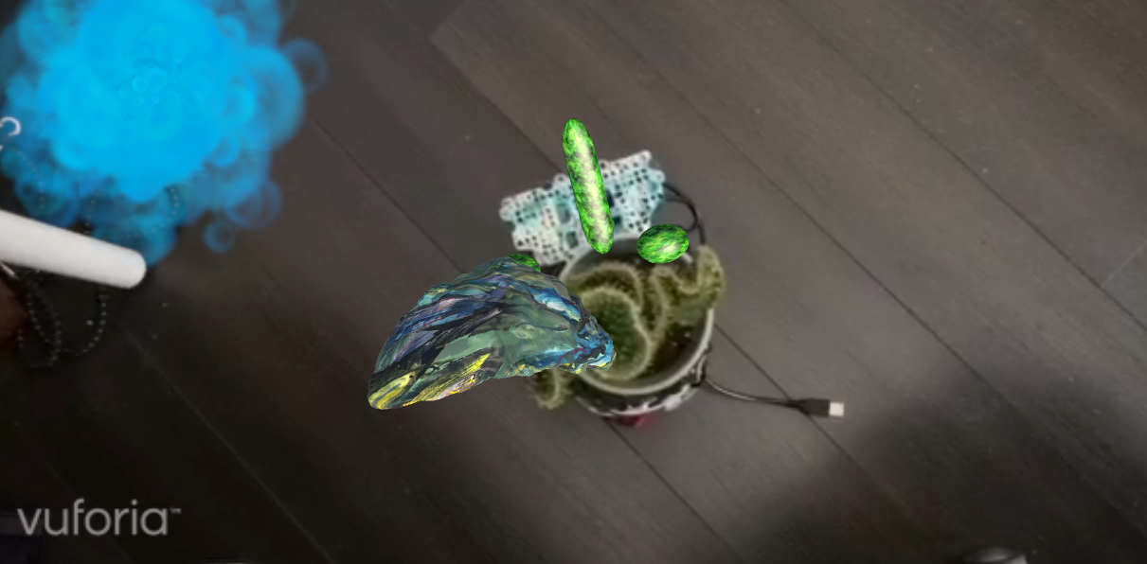
The View in Unity

Slide 9
Box Painting

Slide 10
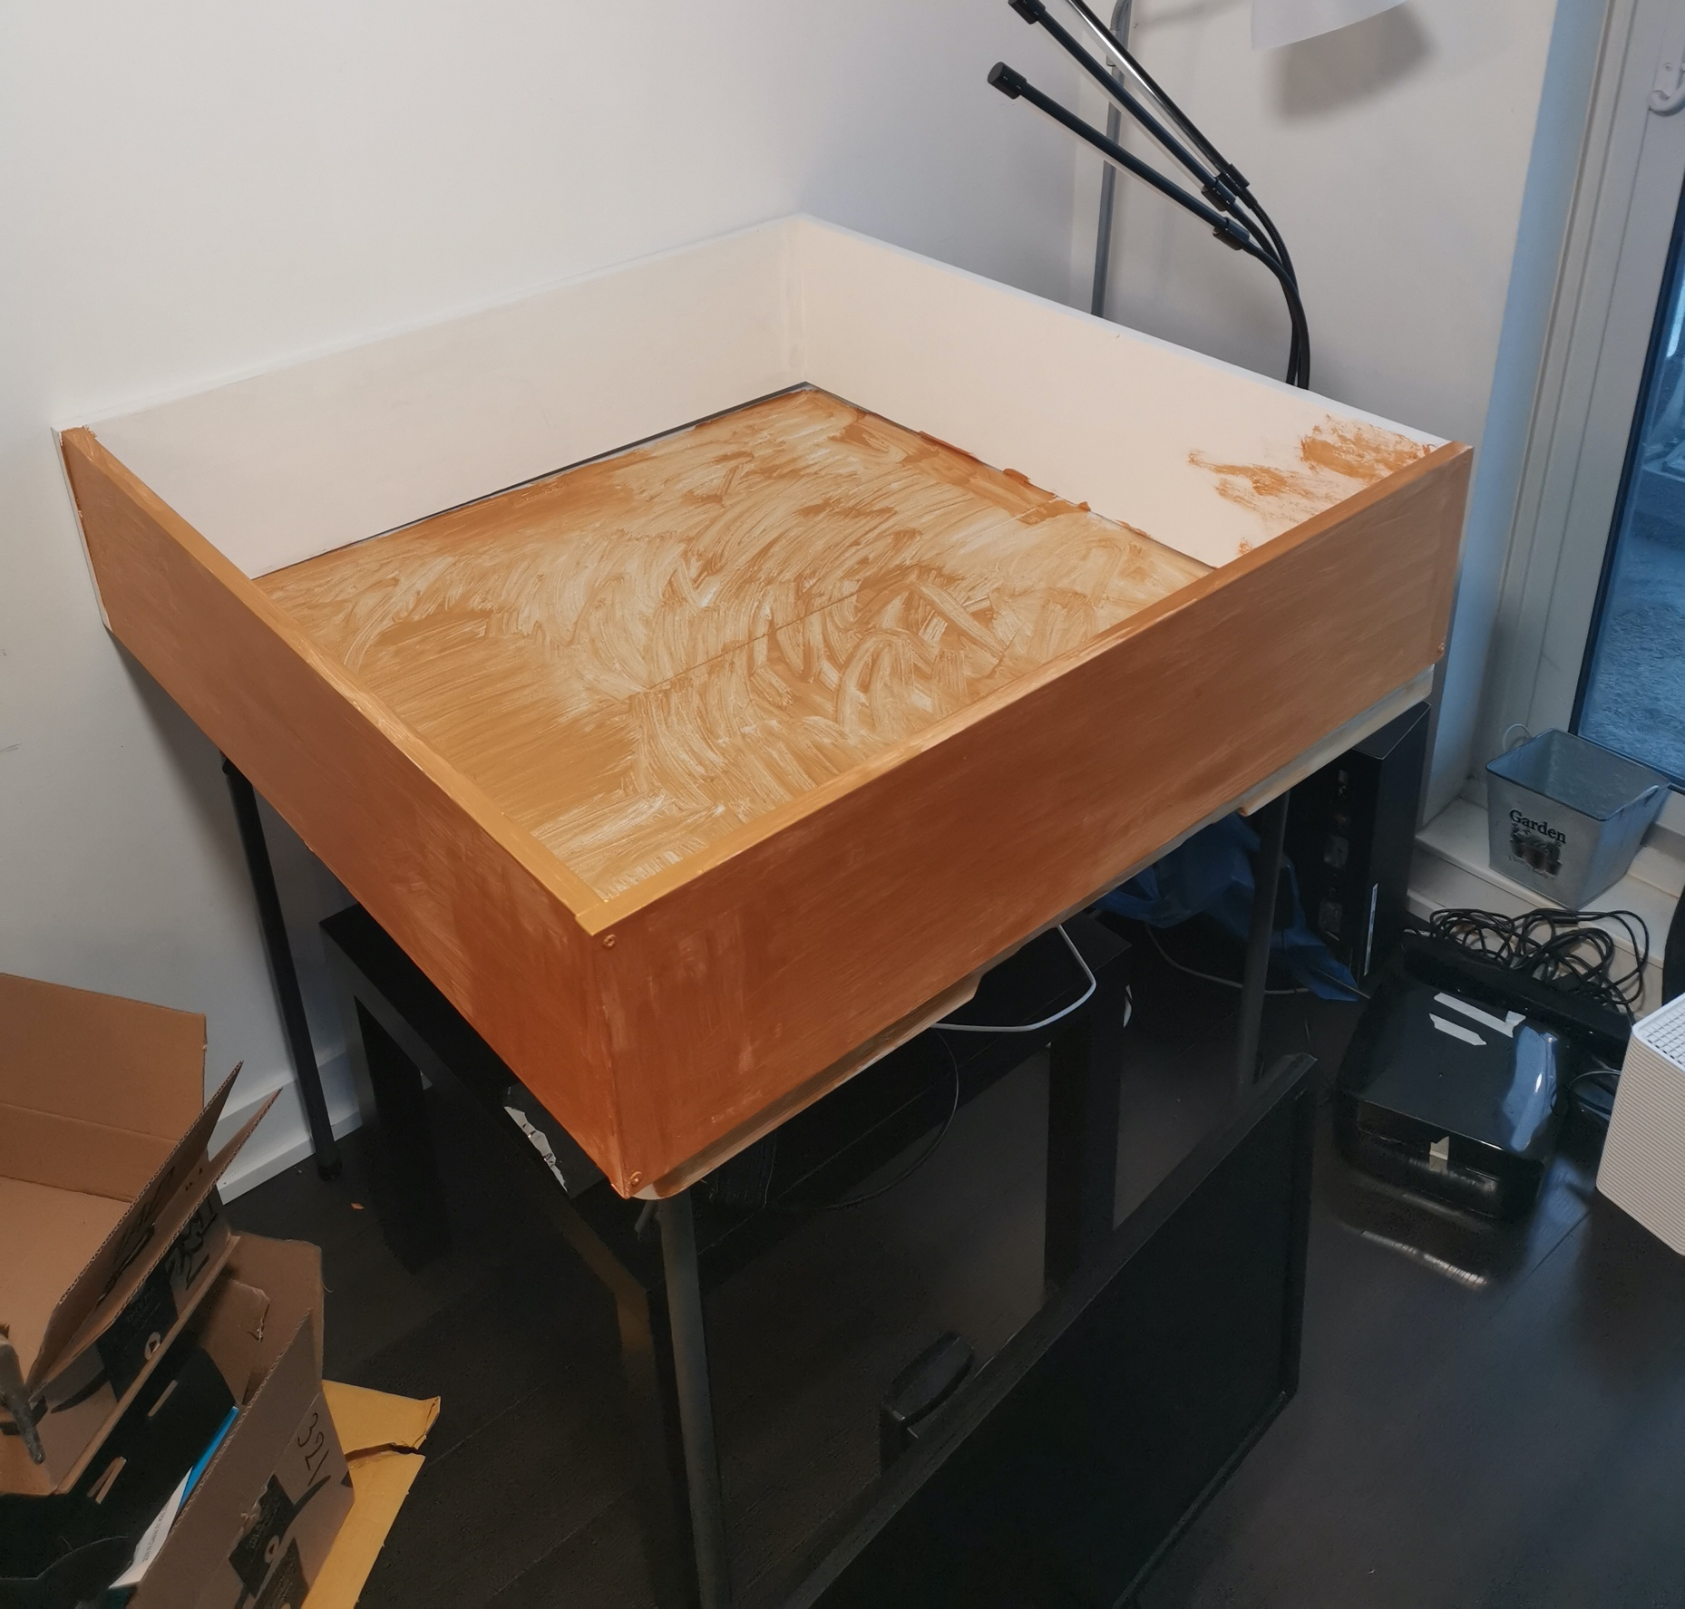
Golden Acrylic – Mental Feeling Exploration

Slide 11
Context Research

Slide 12
[1] G. Burrell, “Modernism, Post Modernism and Organizational Analysis 2: The Contribution of Michel Foucault,” Organ. Stud., vol. 9, no. 2, pp. 221–235, 1988.
[2] A. Giddens, “Modernism and Post-Modernism,” New Ger. Crit., no. 22, p. 15, 1981.
[3] N. Bostrom, “Ethical Issues for the Twenty-First Century: Transhumanist Values,” J. Philos. Res., vol. 30, no. Special Issue, pp. 3–14, 2005.
[4] D. Haraway, “A Cyborg Manifesto: Science, Technology, and Socialist-Feminism in the Late 20th Century,” in The International Handbook of Virtual Learning Environments, 2007, pp. 117–158.
[5] K. Warwick, “Cyborg morals, cyborg values, cyborg ethics,” 2003.

